Slide 1

Try-catch
Presentation by: Norbert Paksi

Slide 2
Included topics
Exceptions
Errors
Exception and error handling
Try-catch-finally blocks
Custom exceptions

Slide 3

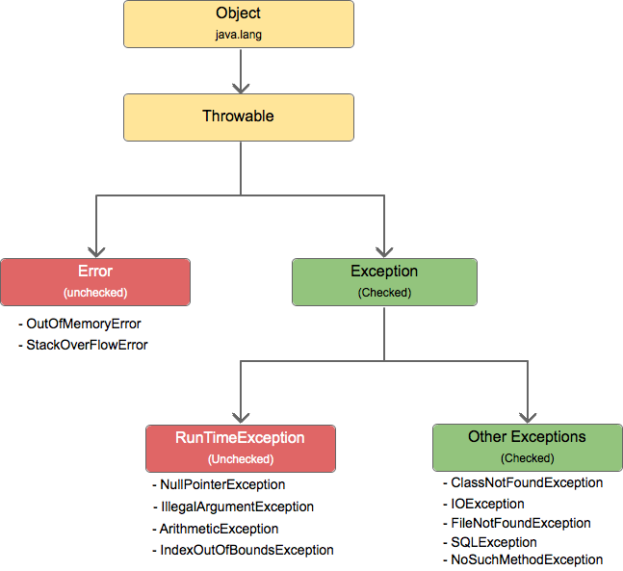

Slide 4

Error
Error : An Error “indicates serious problems that a reasonable application should not try to catch.” Both Errors and Exceptions are the subclasses of java. lang. Throwable class. Errors are the conditions which cannot get recovered by any handling techniques.

Slide 5
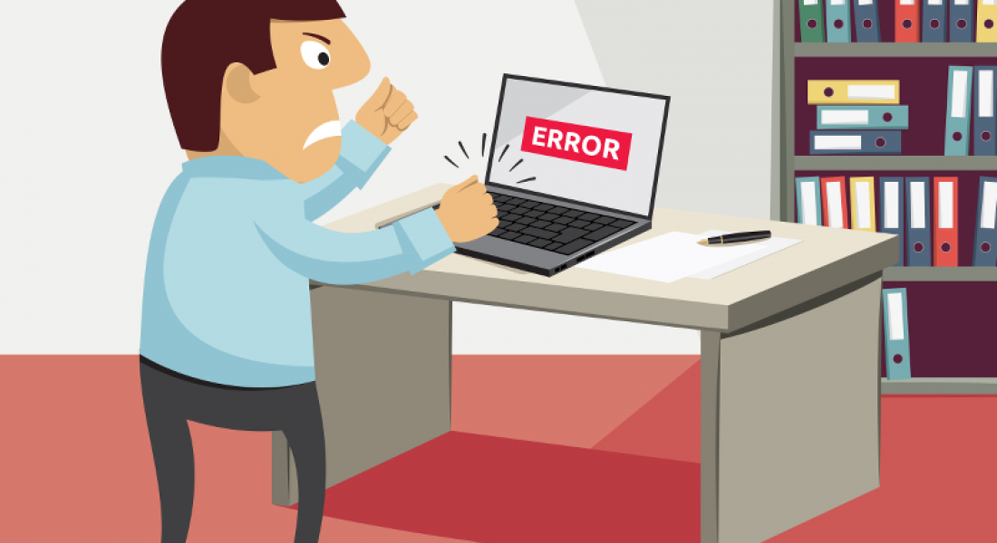

Slide 6
Exception
An exception is an event that occurs during the execution of a program that disrupts the normal flow of instructions. ... When such an error occurs within a Java method, the method creates an exception object and hands it off to the runtime system.

Slide 7
Checked or unchecked?
Checked exceptions are meant to flag a problematic situation that should be handled by the developer who calls your method. It should be possible to recover from such an exception. A good example of this is a FileNotFoundException. Those exceptions are subclasses of Exception.
Unchecked exceptions are meant to represent a bug in your code, an unexpected situation that you might not be able to recover from. A NullPointerException is a classical example. Those exceptions are subclasses of RuntimeException

Slide 8

Throw exception
Creating an exception object and handing it to the runtime system is called throwing an exception. After a method throws an exception, the runtime system attempts to find something to handle it.

Slide 9
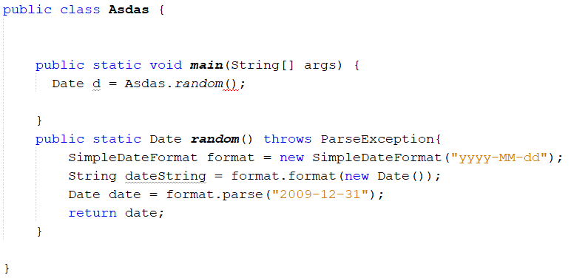
Throw exception to a higher layer
If we have multiple layer applications ( fe.: MVC), we can say we don’t care about this exception in this current layer, and just pass it to another layer.

Slide 10

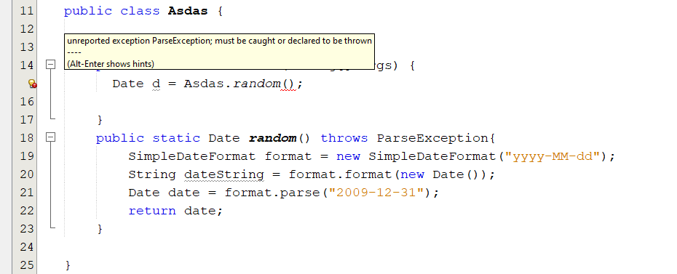
Whats is the problem?

Slide 11
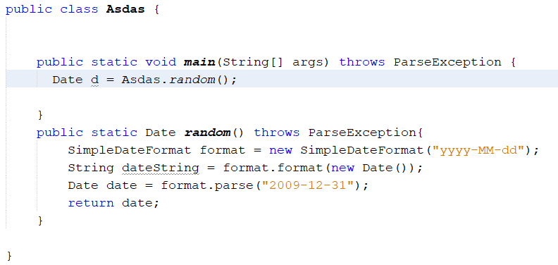
Bad solution – Throw it over again

Slide 12
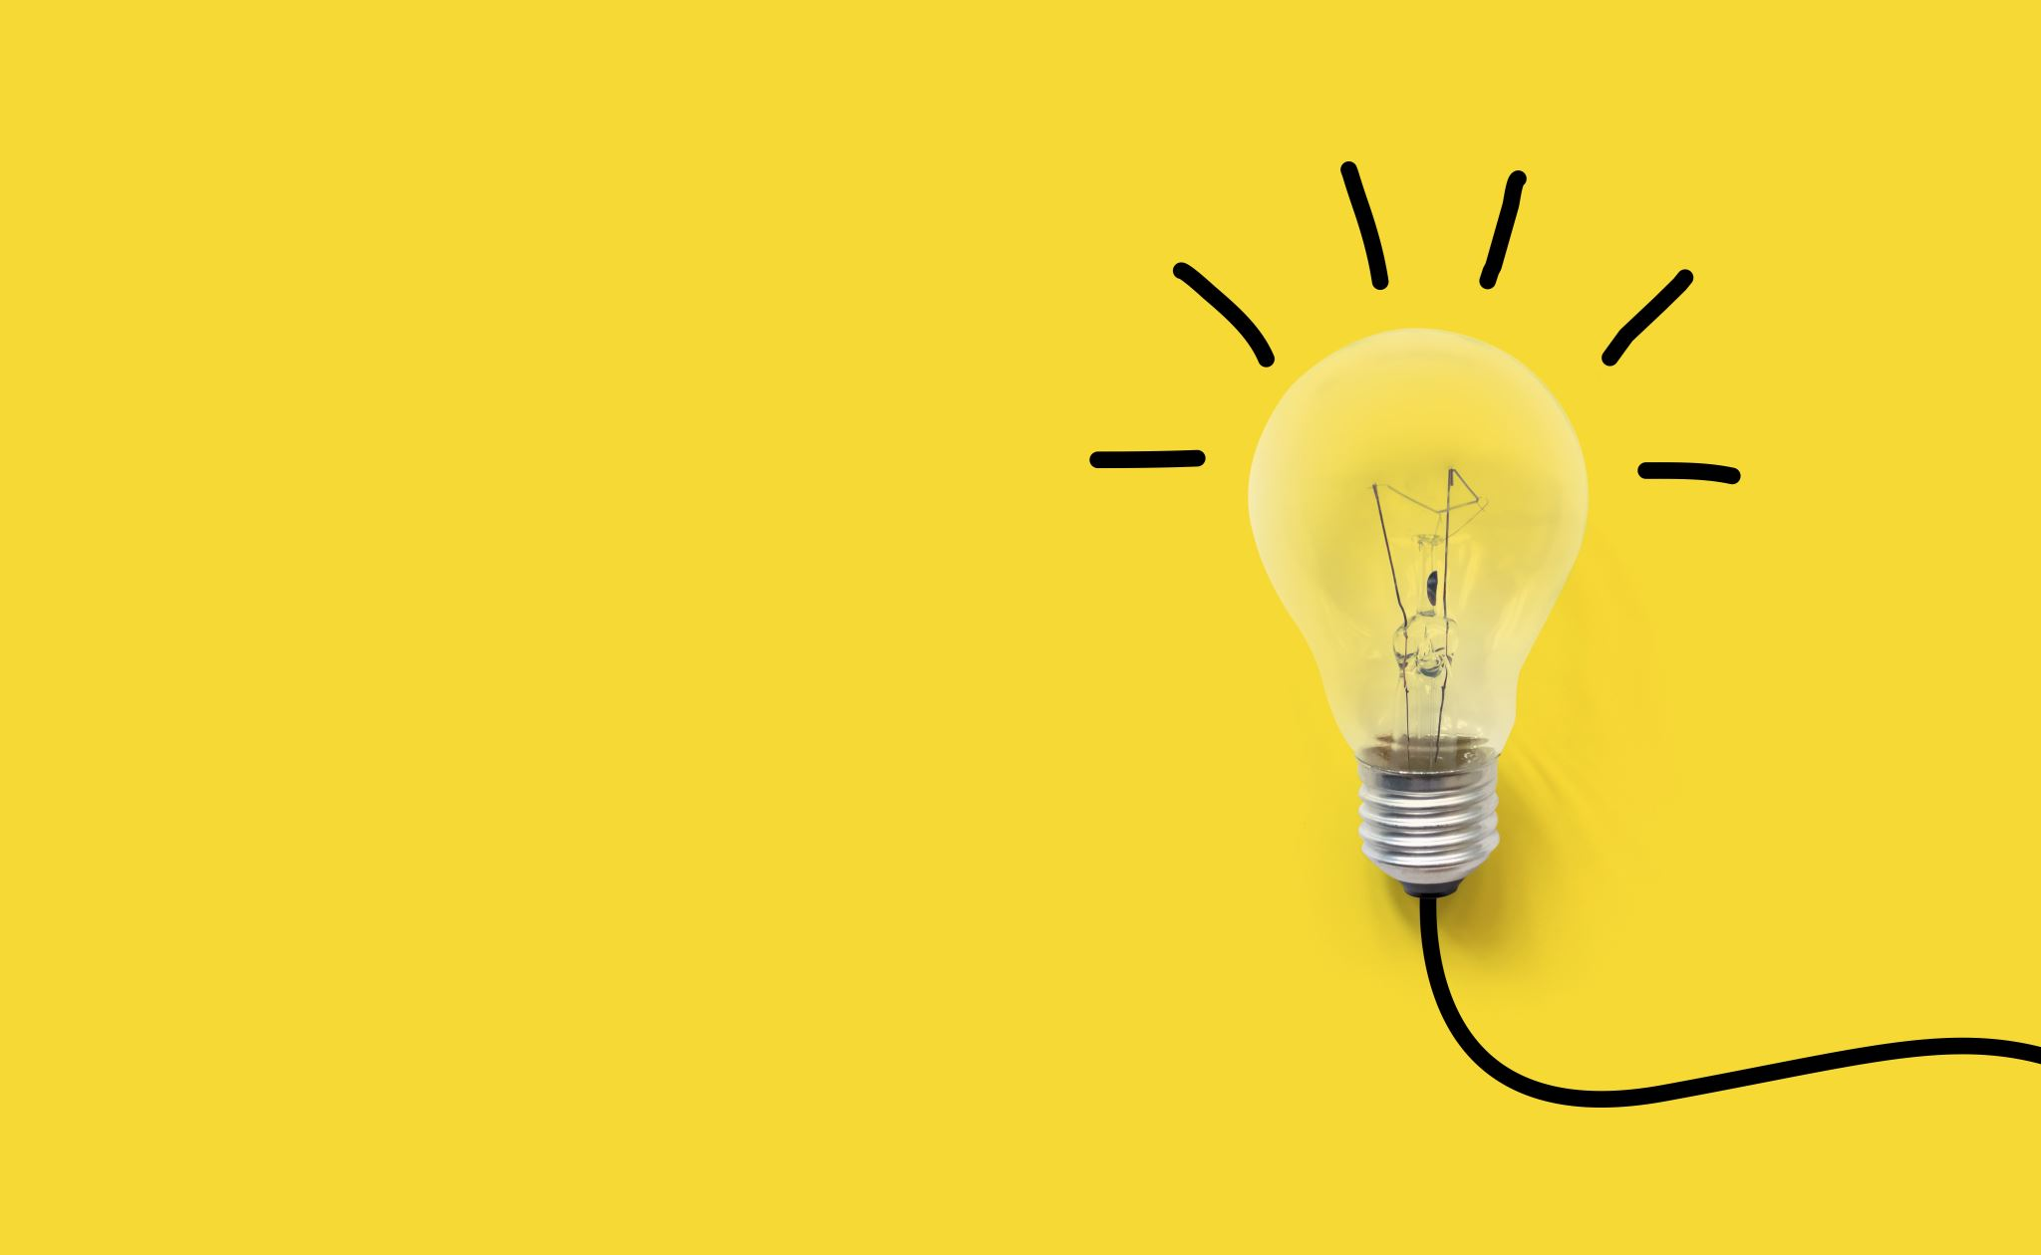
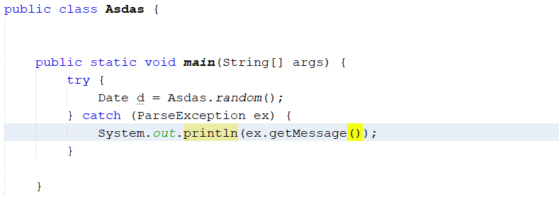
Good solution – Use Try-catch and handle it

Slide 13
When use Try-catch ?

Slide 14
If you choose to handle an exception this way.
If you exposed to any external dependence
Miss typing in the databse
Try to use a non-existing file
etc

Slide 15
What is external dependence ?
A mistake (error / exception ) possibility that affects the operation of the source code but does not originate from the source code.

Slide 16
How to use Try- catch?

Slide 17
If you have a source code part, and it posibly can generate an exception, put this part of code to a try block – Try{}
Try block can have a condition too, so instead of Try{ parse } you can use Try(parse){}, but it’s rarely used
After a try part, you must use catch, because you will catch your thrown exception here.
Catch must have a condition, but it’s actually easier to understand as a function with an input parameter. This parameter will be an exception object, can be a simple Exception, or a specified one like nullPointerException

Slide 18
Your try and catch work like IF and ELSE statements, if one will do the job, the other one won’t.
If your try block works perfectly, the compiler will skipp the catch part
If your try block fail (Just like if with a false statement), the compiler will jump to your catch block, and do the code you write here ( irl it’s most likely a log about the catched exception.)

Slide 19
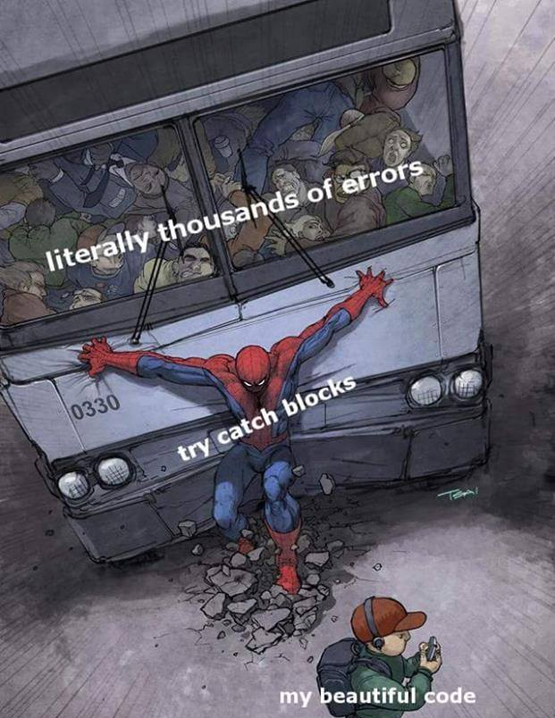

Slide 20

What is finally block?

Slide 21
If you have some instruction you would like to do both Try and Catch parts, you don’t need to put it in both. You can use Finally{} after your catch part, and this part will run and do the job every time

Slide 22
Last, but not least, what is custom exception?
In addition to the built in exceptions, you can define your own.
You can define a construct, and give the message as input when you throw it
You must add throw keyword when you use it
You also need to add throws keyword to the function, where you use throw inside

Slide 23
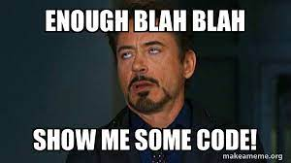
Thank you for your attention!

